Slide 1
Stanford ME469: Midterm Questions and Input File Walk-Through
Stefan P. Domino
Computational Thermal and Fluid Mechanics
Sandia National Laboratories SAND2018-4536 PE

Slide 2
Questions and Input File Walk Through
Typical Questions Fielded
EBVC Input
CVFEM Input

Slide 3
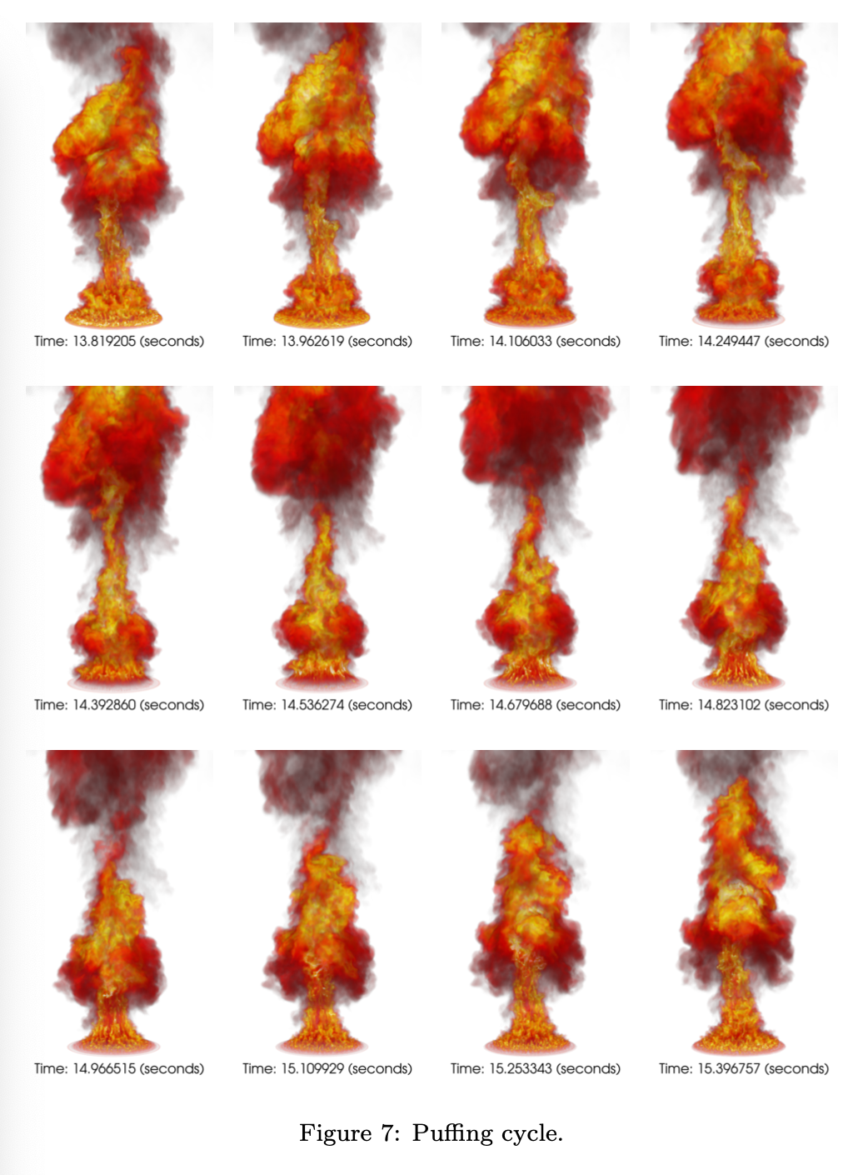
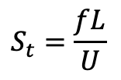
Q1: If the Strouhal number is the QoI, how do I compute that?
$$S_{t}=\frac{fL}{U}$$
The Strouhal number is defined as, where f is a frequency (Hz), L a characteristic length scale, and U a reference velocity
Probing a particular location and/or variable over time will produce a time signal, for example, in this example, we see a turbulent reacting flow example: QoI is the puffing frequency
Computing a FFT of the signal should yield a characteristic peak
Domino et al., “Validation of an unsteady famelet and large-eddy simulation-based model suite for a large-scale JP-8 pool fire”, Submitted, Combust. Flame, 2021

Slide 4
Q2: How do I interpret the timing information?
Recall, that we are running a parallel simulation. Specifically, each processor has been assigned a particular “job”
Efficiency of parallel scaling requires good load-balancing
The code provides min/max/avg/sum timings for key algorithmic paths
It may be interesting for you to look at the timings between CVFEM and EBVC for select operations…
Timing for Eq: MomentumEQS
init -- avg: 5.45713 min: 5.44055 max: 5.47628
assemble -- avg: 16.2114 min: 16.1217 max: 16.2904
load_complete -- avg: 0.160093 min: 0.0851765 max: 0.265414
solve -- avg: 33.4897 min: 33.4544 max: 33.5551
precond setup -- avg: 0.335892 min: 0.272227 max: 0.371449
misc -- avg: 6.38337 min: 6.19594 max: 7.42213
linear iterations -- avg: 18.65 min: 8 max: 38
Min No-output time 136.9932 sec
Avg No-output time 137.0108 sec
Max No-output time 137.0243 sec

Slide 5
Q3: What is a nonlinear residual?
In this vortex street case, we are solving for velocity (momentum), pressure (continuity), and passive scalar (mixture fraction)
Although the mixture fraction equation is decoupled, the continuity and momentum equation are coupled. As such, the level of convergence for this system is captured in the nonlinear residual.
In Nalu, we scale the nonlinear residual by the value obtained at the first time step
{
do while (!converged) {
}
For a given
time step:

Slide 6
Q4: What is Peclet blending again?
A classic advection stabilization approach is to use a Galerkin (or central) operator blended with upwind.
Recall, that the Peclet number for an advection/diffusion equation speaks to the ratio of advective transport rate to diffusive transport rate.
In our early stability analysis, recall that monotonicity was only captured when the cell Peclet number was less that 2
The default Nalu implementation is to use a steep blending function such that for cell Peclet numbers greater than 2, upwind is predominately used.
- peclet_function_form:
velocity: tanh
- peclet_function_tanh_transition:
velocity: 2.0
- peclet_function_tanh_width:
velocity: 4.0

Slide 7
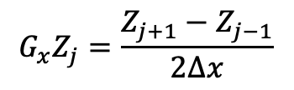
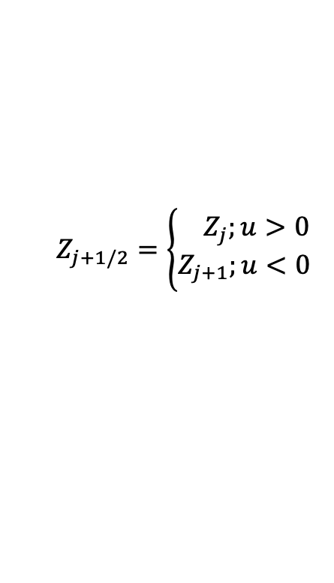
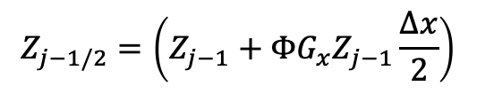
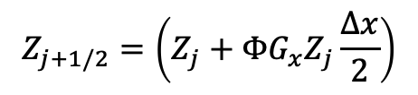
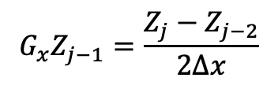
Q5: What is a limiter? Did I miss that?
We only briefly discussed this point, however, we will recall that for an unstructured method, we are generally limited by the amount of data that we can extract for a particular mesh object that we are iterating, e.g., node, edge, face, element
The use of a projected nodal gradient allows for us to extrapolate a higher-order stencil; however, this extrapolation can admit a non-monotonic value within the mesh object
j-1
Z_{j-1/2}
j
Z_{j+1/2}
j+1
$$Z_{j+1/2}=\left\{\begin{aligned}{ Z}_{j};u>0 \\ Z_{j+1};u<0\end{aligned}\right.$$
$$G_{x}Z_{j}=\frac{Z_{j+1}−Z_{j−1}}{2∆x}$$
$$G_{x}Z_{j−1}=\frac{Z_{j}−Z_{j−2}}{2∆x}$$
for u>0
$$Z_{j+1/2}=\left(Z_{j}+{ΦG}_{x}Z_{j}\frac{∆x}{2}\right)$$
$$Z_{j−1/2}=\left(Z_{j−1}+{ΦG}_{x}Z_{j−1}\frac{∆x}{2}\right)$$
- limiter:
velocity: yes
mixture_fraction: no

Slide 8
Q6: Why not a FEM case?
Yes, Nalu supports FEM, however, only with limited element topology support.
Currently, we only support Hex8, Tet4, and (limited) Tri3
Sadly, the street mesh is a Quad4/Tri3 combination
If you are interested in implementing a complete Quad4 and Tri3 element type (or even Quad9, Tri6) within this class, let me know… This could serve an interesting final project☺

Slide 9
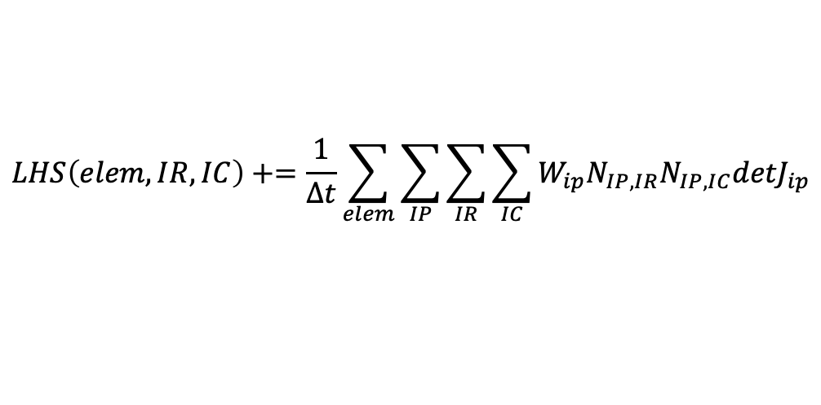
Q7: What is this lumped vs non-lumped option for the time derivative?
﻿ - element_source_terms:
momentum: [momentum_time_derivative]
j-1
Z_{j-1/2}
j
Z_{j+1/2}
j+1
Recall that the EBVC scheme computes time and source terms at the nodes . In the above example, the “lumped mass matrix” stencil is:
h/Δt[0 1 0] (Z_{j-1}, Z_{j}, Z_{j+1})^{T}
For the CVFEM scheme, evaluation of the time/source term at the volume quadrature points . In the above example, this results in a ”consistent mass matrix”:
h/(8Δt)[1 6 1] (Z_{j-1}, Z_{j}, Z_{j+1})^{T}
For the FEM scheme, evaluation of the time/source term at the volume quadrature points . In the above example, this results in a ”consistent mass matrix”:
h/(6Δt)[1 4 1] (Z_{j-1}, Z_{j}, Z_{j+1})^{T}
h
“row sum lump” A_{ii} += A_{ij}, j!=i
CMM reduces numerical dispersion at the cost of reduced diagonal dominance; FEM is symmetric by construct
$$LHS\left(elem,IR,IC\right)+=\frac{1}{Δt}\sum_{elem}{\sum_{IP}{\sum_{IR}{\sum_{IC}{W_{ip}N_{IP,IR}N_{IP,IC}{detJ}_{ip}}}}}$$
(see femMM.C under Canvas Pages)

Slide 10
Q8…QN?
Discussion…. Before CVFEM and EBVC input walk through…
https://github.com/NaluCFD/Nalu/tree/master/examples/street

Slide 11
Stanford ME469: Introduction to the low-Mach Number Approximation
Stefan P. Domino
Computational Thermal and Fluid Mechanics
Sandia National Laboratories SAND2018-4536 PE

Slide 12
Introduction to the low-Mach Number Approximation: Outline
Variable density, non-isothermal equation set
DOF vs Equation count
Non-dimensional form
Asymptotic Expansion
Derived low-Mach Equation Set
The Role of Pressure
Motion and Thermodynamic
Conclusions

Slide 13
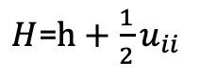
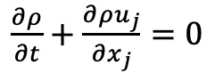
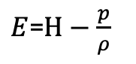
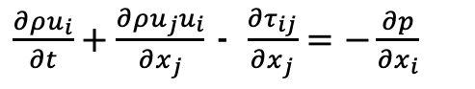
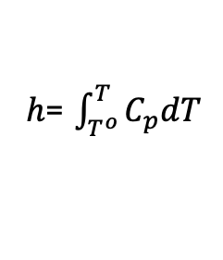
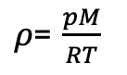
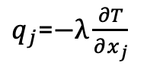
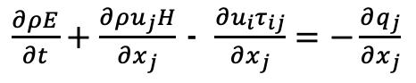
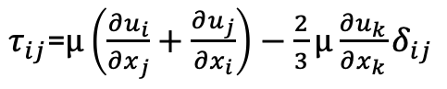
Consider a Variable Density, non-Isothermal Fluid Flow System
Consider the variable density (non-isothermal) equations of motion (momentum and continuity) with energy transport
See Paolucci (1982) or Baum (1978) for the low-Mach pedigree
Number of Equations = (3+nDim) = Number of unknowns
DOF
Density, ρ
Pressure, p
Velocity, u_{i}
Total energy, E
Total enthalpy, H
Static enthalpy, h
Temperature, T
Properties:
Viscosity, μ
Specific heat, C_{p}
Thermal conductivity, λ
Constitutive Relationships
Ideal gas law (+1)
Newtonian stress, τ_{ij}
Heat flux vector, q
Total enthalpy, H
Static enthalpy, h
dh/dT = Cp
$\frac{∂ρ}{∂t}+\frac{∂{ρu}_{j}}{∂x_{j}}$ $=0$
$\frac{∂ρu_{i}}{∂t}+\frac{∂ρu_{j}u_{i}}{∂x_{j}}$ - $\frac{∂τ_{ij}}{∂x_{j}}=−\frac{∂p}{∂x_{i}}$
2+nDim
$\frac{∂ρE}{∂t}+\frac{∂ρu_{j}H}{∂x_{j}}$ - $\frac{∂u_{i}τ_{ij}}{∂x_{j}}=−\frac{∂q_{j}}{∂x_{j}}$
+1
$ρ$= $\frac{pM}{RT}$
$τ_{ij}$=$μ\left(\frac{∂u_{i}}{∂x_{j}}+\frac{∂u_{j}}{∂x_{i}}\right)−\frac{2}{3}μ\frac{∂u_{k}}{∂x_{k}}δ_{ij}$
$q_{j}$=$−λ\frac{∂T}{∂x_{j}}$
$E$=$H−\frac{p}{ρ}$
$H$=$h+\frac{1}{2}u_{ii}$
$h$= $\int_{T^{o}}^{T}{C_{p}dT}$

Slide 14
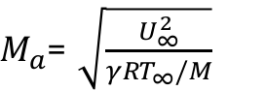
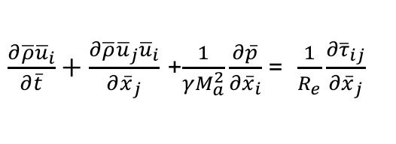
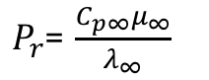
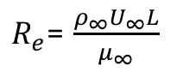
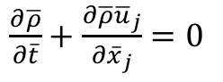
Dimensionless Form
Nondimensionalization is via a characteristic velocity and length scale
Note, as the Mach number approaches zero, the viscous work and kinetic energy terms become negligible
However, the momentum equation notes a singular due to the pressure gradient term
Conclusions: In the limit of zero Mach number, the momentum equation is not well defined and, in fact, singular
$\frac{∂\overline{ρ}}{∂\overline{t}}+\frac{∂\overline{ρ}{\overline{u}}_{j}}{∂{\overline{x}}_{j}}$ $=0$
$\frac{∂\overline{ρ}{\overline{u}}_{i}}{∂\overline{t}}+\frac{∂\overline{ρ}{\overline{u}}_{j}{\overline{u}}_{i}}{∂{\overline{x}}_{j}}$ +$\frac{1}{γM_{a}^{2}}\frac{∂\overline{p}}{∂{\overline{x}}_{i}}$= $\frac{1}{R_{e}}\frac{∂{\overline{τ}}_{ij}}{∂{\overline{x}}_{j}}$
$\frac{∂\overline{ρ}\overline{h}}{∂\overline{t}}+\frac{∂\overline{ρ}{\overline{u}}_{j}\overline{h}}{∂{\overline{x}}_{j}}$ = $−\frac{1}{{P_{r}R}_{e}}\frac{∂{\overline{q}}_{j}}{∂{\overline{x}}_{j}}+\frac{γ−1}{γ}\frac{∂\overline{p}}{∂\overline{t}}+\frac{γ−1}{γ}\frac{M_{a}^{2}}{R_{e}}\frac{∂{\overline{u}}_{i}{\overline{τ}}_{ij}}{∂{\overline{x}}_{j}}$ - $\frac{γ−1}{γ}$ $M_{a}^{2}\left(\frac{∂\overline{ρ}{\overline{u}}_{k}{\overline{u}}_{k}}{∂{\overline{x}}_{j}}+\frac{∂\overline{ρ}{\overline{u}}_{j}{\overline{u}}_{k}{\overline{u}}_{k}}{∂{\overline{x}}_{j}}\right)$
$R_{e}$= $\frac{ρ_{∞}U_{∞}L}{μ_{∞}}$
$P_{r}$= $\frac{C_{p∞}μ_{∞}}{λ_{∞}}$
$M_{a}$= $\sqrt{\frac{U_{∞}^{2}}{{γRT}_{∞}/M}}$

Slide 15
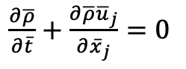
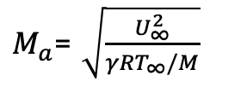
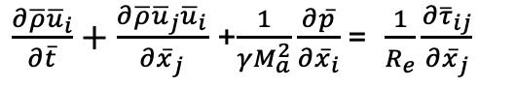
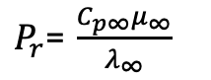
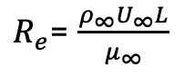
Dimensionless Form
Nondimensionalization is via a characteristic velocity and length scale
Note, as the Mach number approaches zero, the viscous work and kinetic energy terms become negligible
However, the momentum equation notes a singular due to the pressure gradient term
Conclusions: In the limit of zero Mach number, the momentum equation is not well defined and, in fact, singular
$\frac{∂\overline{ρ}}{∂\overline{t}}+\frac{∂\overline{ρ}{\overline{u}}_{j}}{∂{\overline{x}}_{j}}$ $=0$
$\frac{∂\overline{ρ}{\overline{u}}_{i}}{∂\overline{t}}+\frac{∂\overline{ρ}{\overline{u}}_{j}{\overline{u}}_{i}}{∂{\overline{x}}_{j}}$ +$\frac{1}{γM_{a}^{2}}\frac{∂\overline{p}}{∂{\overline{x}}_{i}}$= $\frac{1}{R_{e}}\frac{∂{\overline{τ}}_{ij}}{∂{\overline{x}}_{j}}$
$\frac{∂\overline{ρ}\overline{h}}{∂\overline{t}}+\frac{∂\overline{ρ}{\overline{u}}_{j}\overline{h}}{∂{\overline{x}}_{j}}$ = $−\frac{1}{{P_{r}R}_{e}}\frac{∂{\overline{q}}_{j}}{∂{\overline{x}}_{j}}+\frac{γ−1}{γ}\frac{∂\overline{p}}{∂\overline{t}}+\frac{γ−1}{γ}\frac{M_{a}^{2}}{R_{e}}\frac{∂{\overline{u}}_{i}{\overline{τ}}_{ij}}{∂{\overline{x}}_{j}}$ - $\frac{γ−1}{γ}$ $M_{a}^{2}\left(\frac{∂\overline{ρ}{\overline{u}}_{k}{\overline{u}}_{k}}{∂{\overline{x}}_{j}}+\frac{∂\overline{ρ}{\overline{u}}_{j}{\overline{u}}_{k}{\overline{u}}_{k}}{∂{\overline{x}}_{j}}\right)$
$R_{e}$= $\frac{ρ_{∞}U_{∞}L}{μ_{∞}}$
$P_{r}$= $\frac{C_{p∞}μ_{∞}}{λ_{∞}}$
$M_{a}$= $\sqrt{\frac{U_{∞}^{2}}{{γRT}_{∞}/M}}$

Slide 16
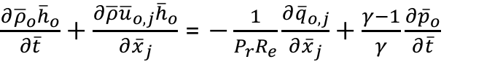
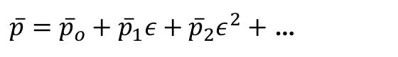
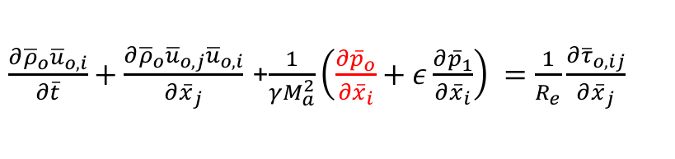
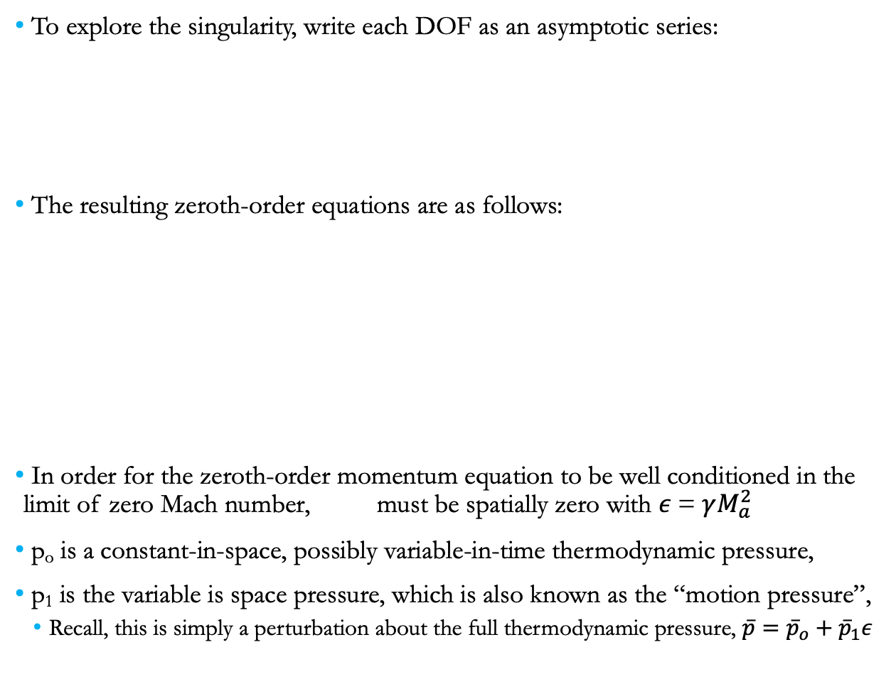
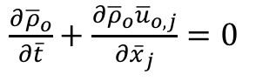
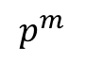
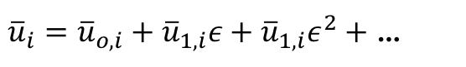
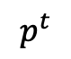
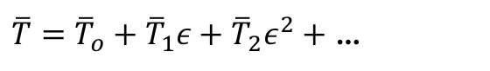
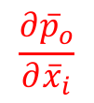
Exploration of the Pressure Singularity
To explore the singularity, write each DOF as an asymptotic series:
The resulting zeroth-order equations are as follows:
In order for the zeroth-order momentum equation to be well conditioned in the limit of zero Mach number, must be spatially zero with $ε$= $γM_{a}^{2}$
p_{o} is a constant-in-space, possibly variable-in-time thermodynamic pressure,
p₁ is the variable is space pressure, which is also known as the “motion pressure”,
Recall, this is simply a perturbation about the full thermodynamic pressure, $\overline{p}={\overline{p}}_{o}+{\overline{p}}_{1}ε$
$\overline{p}={\overline{p}}_{o}+{\overline{p}}_{1}ε+{\overline{p}}_{2}ε^{2}+$ …
${\overline{u}}_{i}={\overline{u}}_{o,i}+{\overline{u}}_{1,i}ε+{\overline{u}}_{1,i}ε^{2}+$ …
$\overline{T}={\overline{T}}_{o}+{\overline{T}}_{1}ε+{\overline{T}}_{2}ε^{2}+$ …
$\frac{∂{\overline{ρ}}_{o}}{∂\overline{t}}+\frac{∂{\overline{ρ}}_{o}{\overline{u}}_{o,j}}{∂{\overline{x}}_{j}}$ $=0$
Used in EOS/u_{i} eq
$\frac{∂{\overline{ρ}}_{o}{\overline{u}}_{o,i}}{∂\overline{t}}+\frac{∂{\overline{ρ}}_{o}{\overline{u}}_{o,j}{\overline{u}}_{o,i}}{∂{\overline{x}}_{j}}$ +$\frac{1}{γM_{a}^{2}}\left(\frac{∂{\overline{p}}_{o}}{∂{\overline{x}}_{i}}+ε\frac{∂{\overline{p}}_{1}}{∂{\overline{x}}_{i}}\right) =\frac{1}{R_{e}}\frac{∂{\overline{τ}}_{o,ij}}{∂{\overline{x}}_{j}}$
$\frac{∂{\overline{ρ}}_{o}{\overline{h}}_{o}}{∂\overline{t}}+\frac{∂\overline{ρ}{\overline{u}}_{o,j}{\overline{h}}_{o}}{∂{\overline{x}}_{j}}$ = $−\frac{1}{{P_{r}R}_{e}}\frac{∂{\overline{q}}_{o,j}}{∂{\overline{x}}_{j}}+\frac{γ−1}{γ}\frac{∂{\overline{p}}_{o}}{∂\overline{t}}$
$$\frac{∂{\overline{p}}_{o}}{∂{\overline{x}}_{i}}$$
$$p^{t}$$
$$p^{m}$$

Slide 17
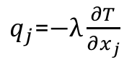
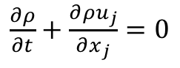
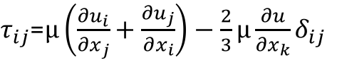
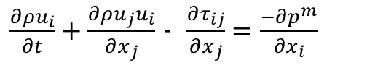
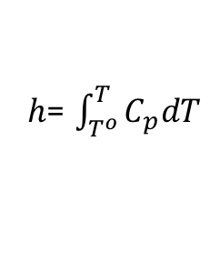
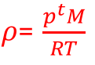
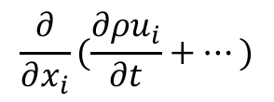
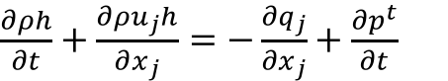
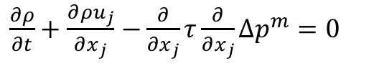
The Final low-Mach Number Equation Set
In dimensional form, the low-Mach system is as follows:
Ramifications?
We have effectively filtered out the acoustics, i.e., the wave speed is infinitely fast
Continuity is met over any finite length instantly
DOF/Equation system is: ρ, p^{m}, u_{i}, h; p^{t} is a constant for an open domain
In practice, a functional form for the motion pressure is derived:
- or
$\frac{∂ρ}{∂t}+\frac{∂{ρu}_{j}}{∂x_{j}}$ $=0$
DOF
Density, ρ
Pressure, p^{m}
Velocity, u_{i}
Total energy, E
Total enthalpy, H
Static enthalpy, h
Temperature, T
Properties:
Viscosity, μ
Specific heat, C_{p}
Thermal conductivity, λ
Constitutive Relationships
Ideal gas law
Newtonian stress, τ_{ij}
Heat flux vector, q
Total enthalpy, H
Static enthalpy, h
CpdT
$\frac{∂ρu_{i}}{∂t}+\frac{∂ρu_{j}u_{i}}{∂x_{j}}$ - $\frac{∂τ_{ij}}{∂x_{j}}=\frac{−∂p^{m}}{∂x_{i}}$
2+nDim
$\frac{∂ρh}{∂t}+\frac{∂ρu_{j}h}{∂x_{j}}$ $=−\frac{∂q_{j}}{∂x_{j}}+\frac{∂p^{t}}{∂t}$
$ρ$= $\frac{p^{t}M}{RT}$
$τ_{ij}$=$μ\left(\frac{∂u_{i}}{∂x_{j}}+\frac{∂u_{j}}{∂x_{i}}\right)−\frac{2}{3}μ\frac{∂u}{∂x_{k}}δ_{ij}$
$q_{j}$=$−λ\frac{∂T}{∂x_{j}}$
$h$= $\int_{T^{o}}^{T}{C_{p}dT}$
$$\frac{∂}{∂x_{i}}(\frac{∂ρu_{i}}{∂t}+…)$$
Pressure Poisson Equation
(PPE)
$\frac{∂ρ}{∂t}+\frac{∂{ρu}_{j}}{∂x_{j}}$ $−\frac{∂}{∂x_{j}}τ\frac{∂}{∂x_{j}}Δp^{m}=0$

Slide 18
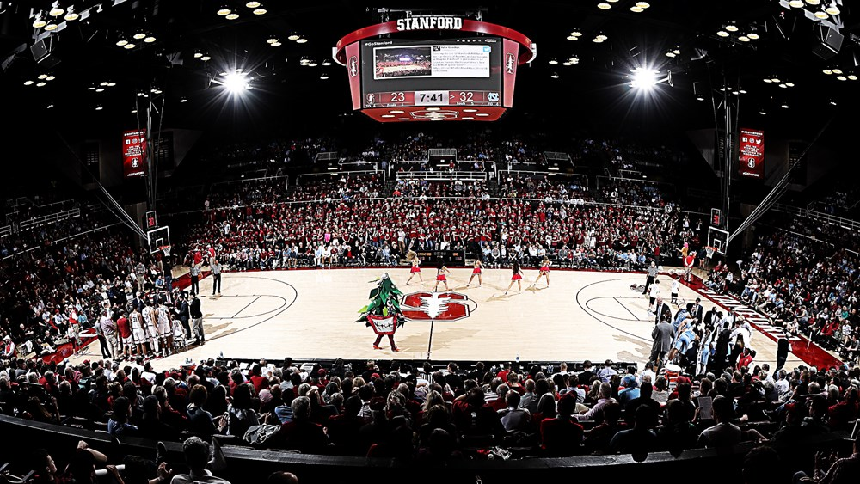
Thought Experiment…
Large domain, one door, one “exit”
Maples Pavilion

Slide 19
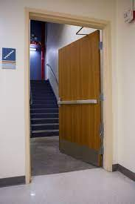
Thought Experiment…
Large domain, one door, one “exit”

Slide 20
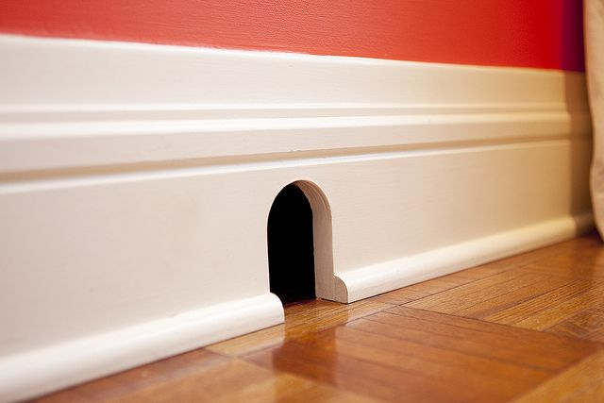
Thought Experiment…
Large domain, one door, one “exit”

Slide 21
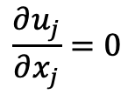
Thought Experiment…
Large domain, one door, one “exit”
Walls
$$\frac{∂u_{j}}{∂x_{j}}=0$$
Inflow
Outflow
Walls

Slide 22

Thought Experiment…
Large domain, one door, one “exit”
Walls
$$\frac{∂u_{j}}{∂x_{j}}=0$$
$$\int{u_{j}n_{j}dS}=0$$
Inflow
Out – In = 0 (at t = to+0.0000000001
Outflow
Walls

Slide 23
Introduction to the low-Mach Number Approximation: Conclusions
Variable density, non-isothermal equation set allow for all length and time scales for a given physics
The non-dimensional form of the momentum equation is singular in the limit as Mach number approaches zero
low-Mach equations are derived by nondimensionalization and asymptotic expansion
For a low-Mach flow, the density and thermodynamic pressure are not strongly coupled by an equation of state, hence, stiffness arises as Ma->0
The constant-in-space thermodynamic pressure is used in the EOS
The low-Mach procedure filters the acoustics, which can not be of prime interest in the flow

